Slide 1

IMDB DATABASE ANALYSIS ADVANCED SQL PROJECT
SANJAIKUMAR S
07/04/2025
DA DS
FEB’2025

Slide 2
IMDB-Database-Tables
Director mapping:
Maps movies to their directors.
Genre:
Describes the genres associated with each movie.
Movie:
Contains basic information about each movie, including title, release year, duration, country, income, languages, and production companies.
Names:
Stores information about people (actors, directors, etc.), including their birthdates, heights, and known movies.
Ratings:
Contains ratings information for movies, including the average rating, total votes, and median rating.
Role mapping:
Maps actors/actresses to movies and specifies the role category.

Slide 3
DATASET OVERVIEW
Total movies : 7997
Total directors : 3867
Total actor : 9362
Total actress : 6253
Most movie by produced country : USA 2260
Genre: 14662 records
Top language : English 4134

Slide 4
Movie
Highest Votes: 'tt4154756', '725138', 'Avengers: Infinity War'
Lowest Votes: 'tt8672516', '100', 'Antony & Cleopatra’
Popular Genre: '4285', 'Drama’
Top Production Company: production_ company, count(production _ company)'Netflix', ‘20’.

Slide 5
Monthly wise Movie release data
Highest releases: March (824) and September (809).
Lowest releases: December (438).
Total movies: 7,997

Slide 6
Year wise analysis
2017 had the highest number of movie releases (3052) and is ranked 1.
2018 follows with 2,944 movies, ranked 2.
2019 saw a significant drop to 2,001 movies , ranked 3.

Slide 7
Ratings and votes
Highest votes : Rating 8 (903,276 votes) and 7 (686,276 votes).
Lowest votes : Rating 1 (447 votes) and 3 (430 votes).
Extreme outlier : Rating 5 (52,1112 votes) stands out from the trend.
Total votes : 1,833,001.

Slide 8
Genre wise
Drama (4,285) – Most popular by far
Comedy (2,412) – strong second places
Thriller (1,484) and Action (1,289) – next most common
Horror (1,208)
Crime (813)
Romance (906)
Adventure (591)
Mystery (555)
Sci-fi (375)
Fantasy (342)
Family (302)
Others (100)

Slide 9
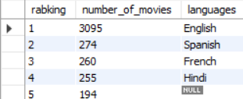
Movie based analysis
English (3,095 movies) – overwhelming leader.
Secondary languages:
Spanish (274)
French (260)
Hindi (255)
Null / unspecified (194) – significant number of films without language data
Total movies represented : 4,078 (sum of shown languages)

Slide 10
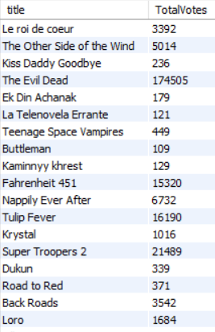
Query & Output
Determine the total number of votes for each movie released in 2018.
QUERY:
SELECT m.title, SUM(r.total_votes) AS TotalVotesFROM movie m
JOIN ratings r ON m.id = r.movie_id
WHERE year = 2018GROUP BY m.title;

Slide 11
Conclusion
Monthly Trends: A downward trend is observed, with peaks in March, September, and October.
Yearly Trends: 2017 has the highest movie count, while 2019 has the lowest.
Genre Analysis: Drama is the most popular genre, presenting opportunities for directors to explore.
Rating and Voting Trends: The database shows a decline in movie ratings and votes year-over-year, highlighting the need to encourage more people to rate and vote for movies.

Slide 12
Thank you

